Slide 1
COMP30810 Intro to Text Analytics
Dr. Binh Thanh Le
thanhbinh.le@ucd.ie
Insight Centre for Data Analytics
School of Computer Science
University College Dublin

Slide 2
Today Goals:
Understand the Supervised Learning
Understand Supervised Learning Process
Understand Classifier, Classification
Understand Classification vs. Regression
Understand Train | Test | Validation

Slide 3
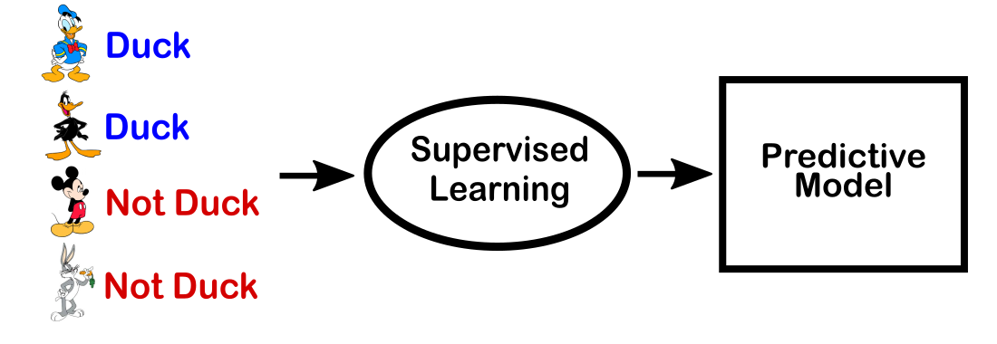
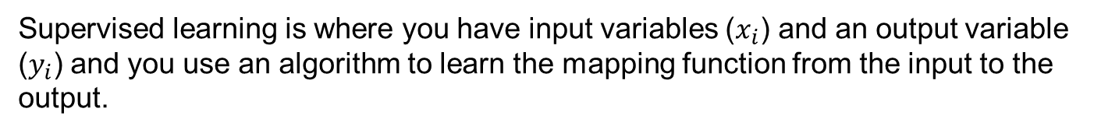


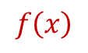
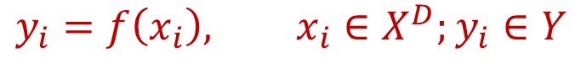
What is Supervised Learning?
$$Y$$
$$X$$
$$f\left(x\right)$$
Supervised learning is where you have input variables ($x_{i}$) and an output variable ($y_{i}$) and you use an algorithm to learn the mapping function from the input to the output.
$$y_{i}=f\left(x_{i}\right), x_{i}∈X^{D};y_{i}∈Y$$

Slide 4
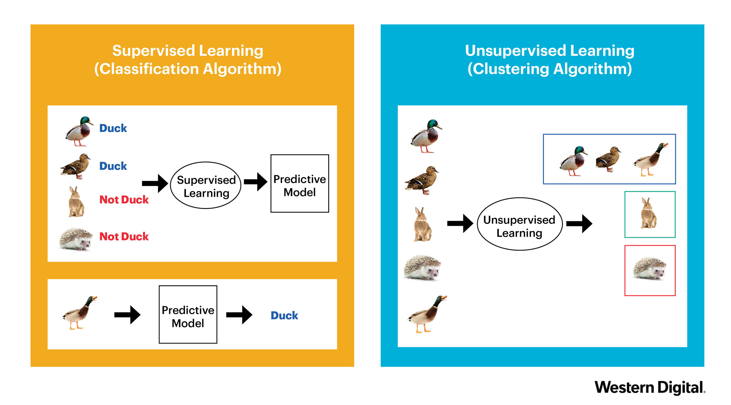
Supervised vs Unsupervised

Slide 5
What is label (class)?
Definition: The class label is the category where the data is “labelled” or “tagged” or “classified” to belong to a specific class based on their common property or attribute.
The different names: target, class, label.
Value of this vector can be:
+ Categorical | discrete values: Classification problem
+ Continuous values: Regression problem
(Please give some examples for each problem)
Label is output, label is also the input for learning step.
For output, label is what we want to predict
For input, label can help to get better model
(Confused?)
The labels are very expensive.
➔ Need a human annotator to determine the value.

Slide 6
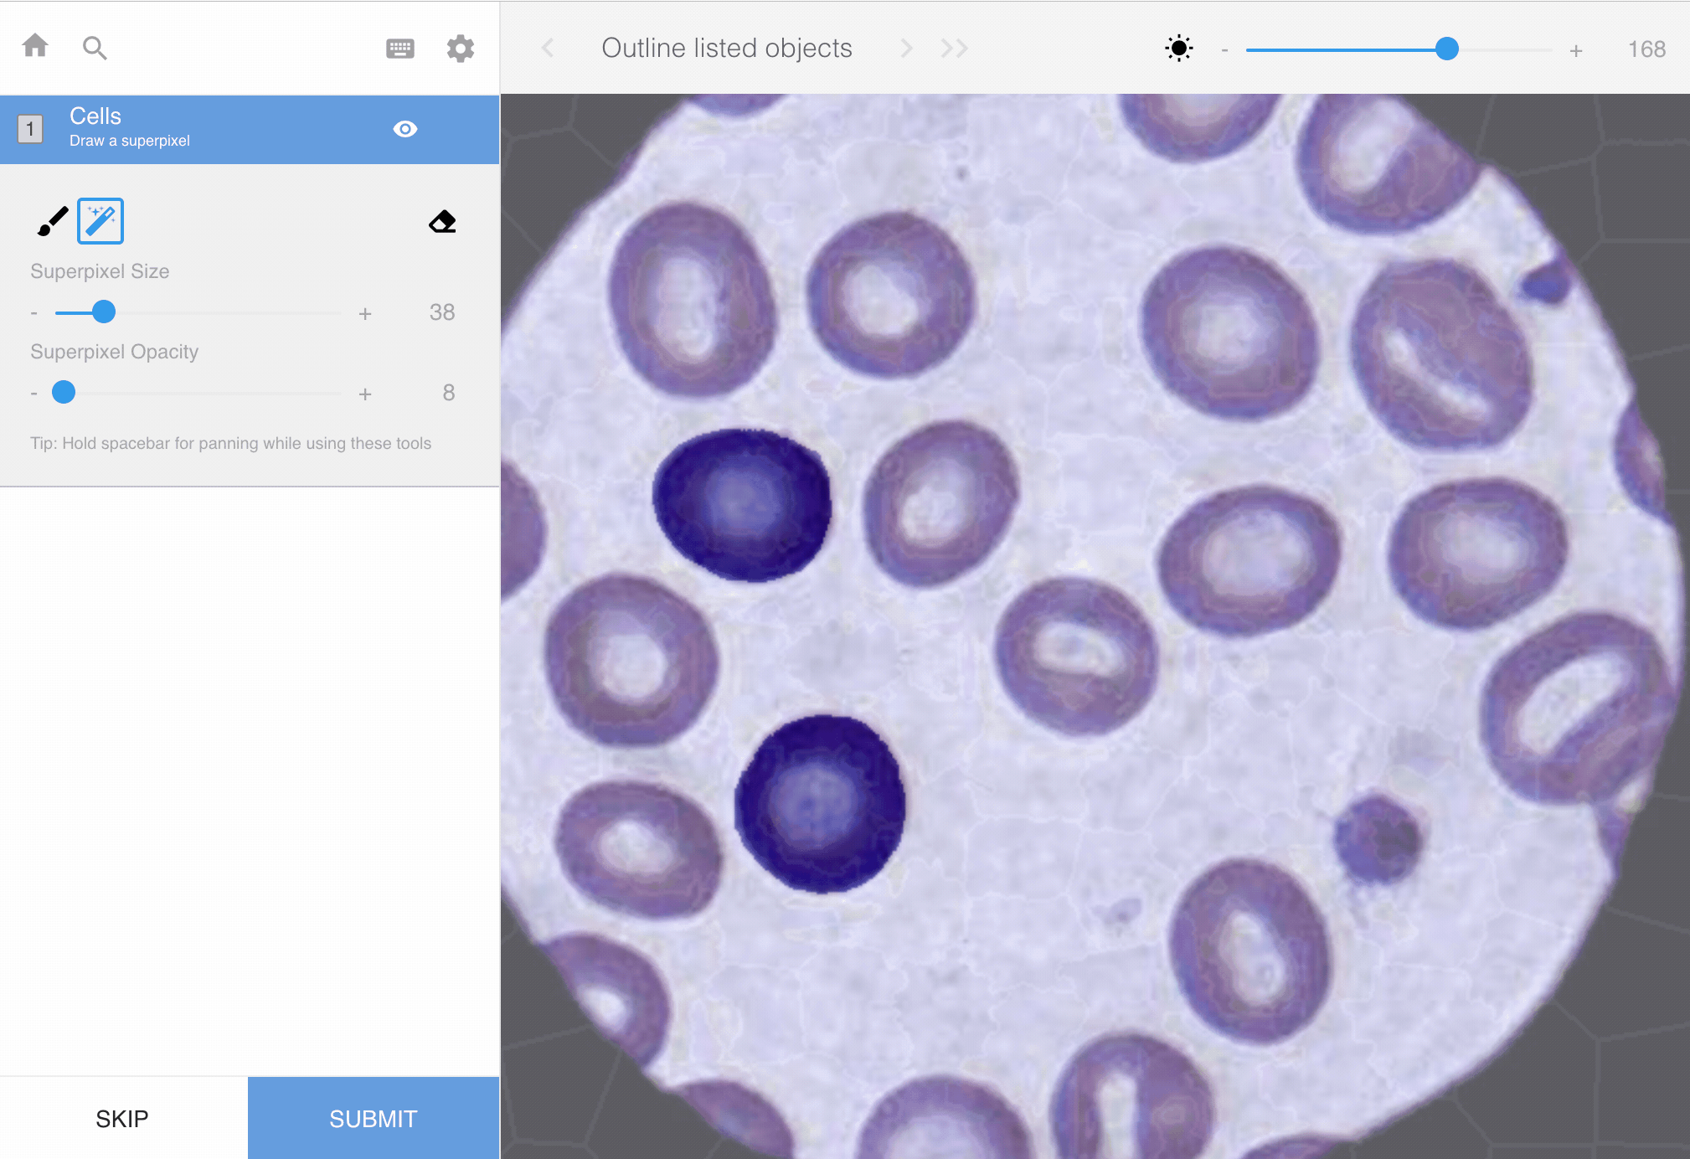
Example of Annotator (annotation tools)
For pictures (biology science)

Slide 7
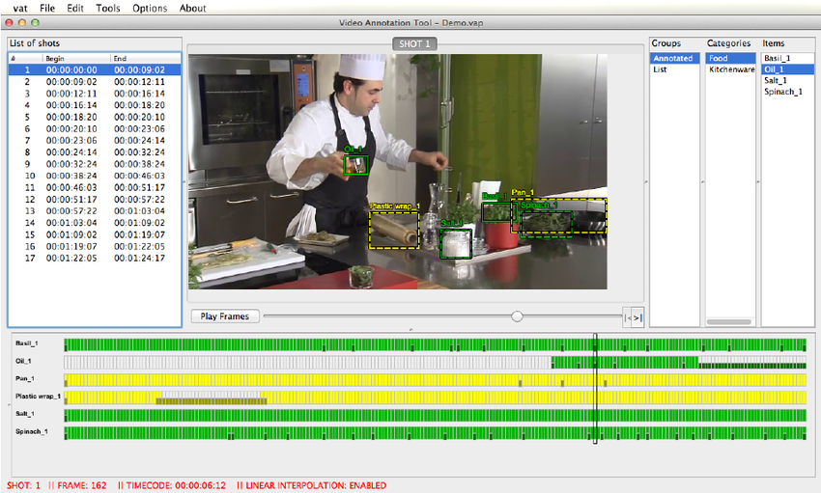
Example of Annotator (Labelling tools)
For Video Frames (health science)

Slide 8
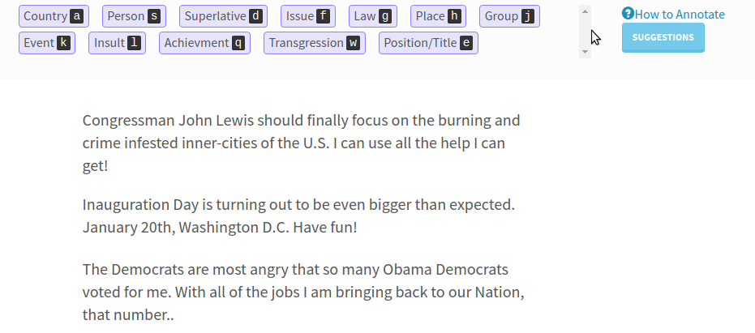
Example of Annotator (Labelling tools)
For Text - words (Text Analytics)

Slide 9
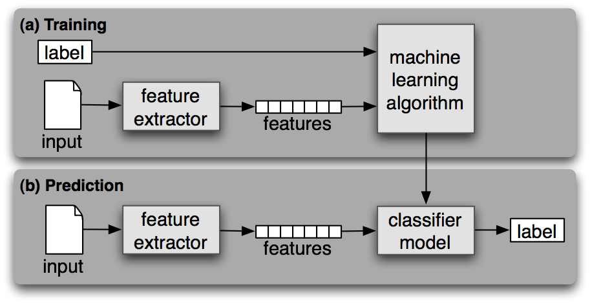
Supervised Learning Process

Slide 10
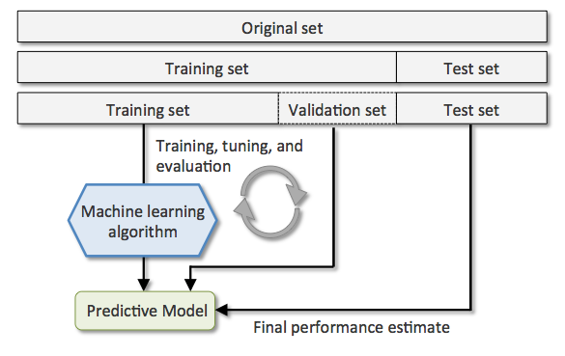
Train ? Test ? [Validation ?]
Train: Learning
Validation: Checking
Test: Applying
Your dataset (corpus)
Checking finished!

Slide 11

Why do we need to split train and test set?
Read a book
Listen to a trainer
Watch a figure
Watch a demo
Have a conversation
Practice a training
Knowledge
database

Slide 12

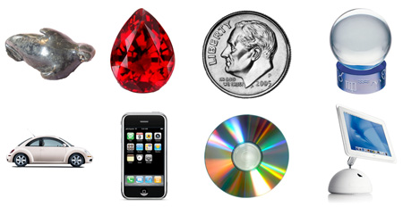
Learn
Learning
What
Where
When
Who
Why
How
Knowledge
database
Test
Objects

Slide 13


Learn & Check many times
Test MODEL
Learn MODEL
Information
database
?
Objects
Decision
What is it ?
LABEL

Slide 14
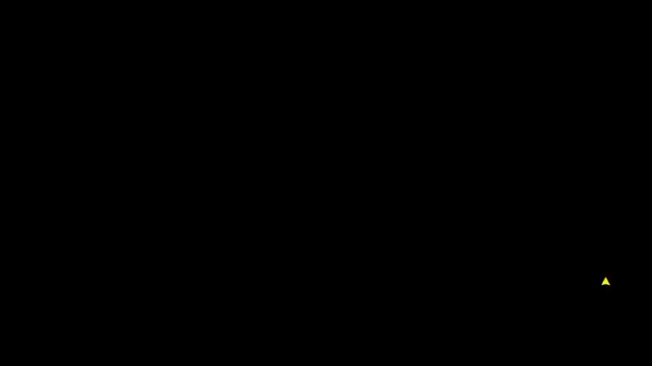
How the machine
could identify
“JAMES TILLER” → Worthless ?
Test sample
Label

Slide 15
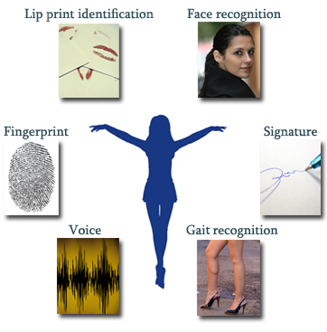
Real application programs

Slide 16

Real application programs

Slide 17

Real application programs

Slide 18
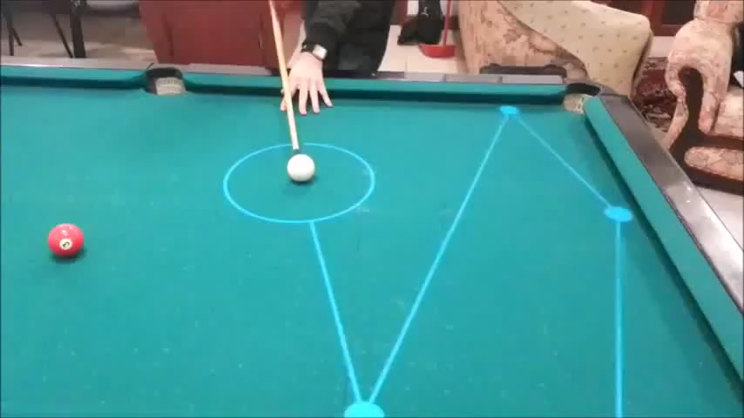
Real application programs

Slide 19
Summary
Supervised Learning is learning with the guiding of label vector.
Classification: Categorical | Discrete label
Regression: Continuous label
Label Annotation is the step to mark the label manually by human annotator.
The process of learning: Train -> Validation -> Test
The validation step is used for checking the model and retrain if necessary.
The test step is just the applying the model to test samples to obtain the predicted labels.

